Slide 1
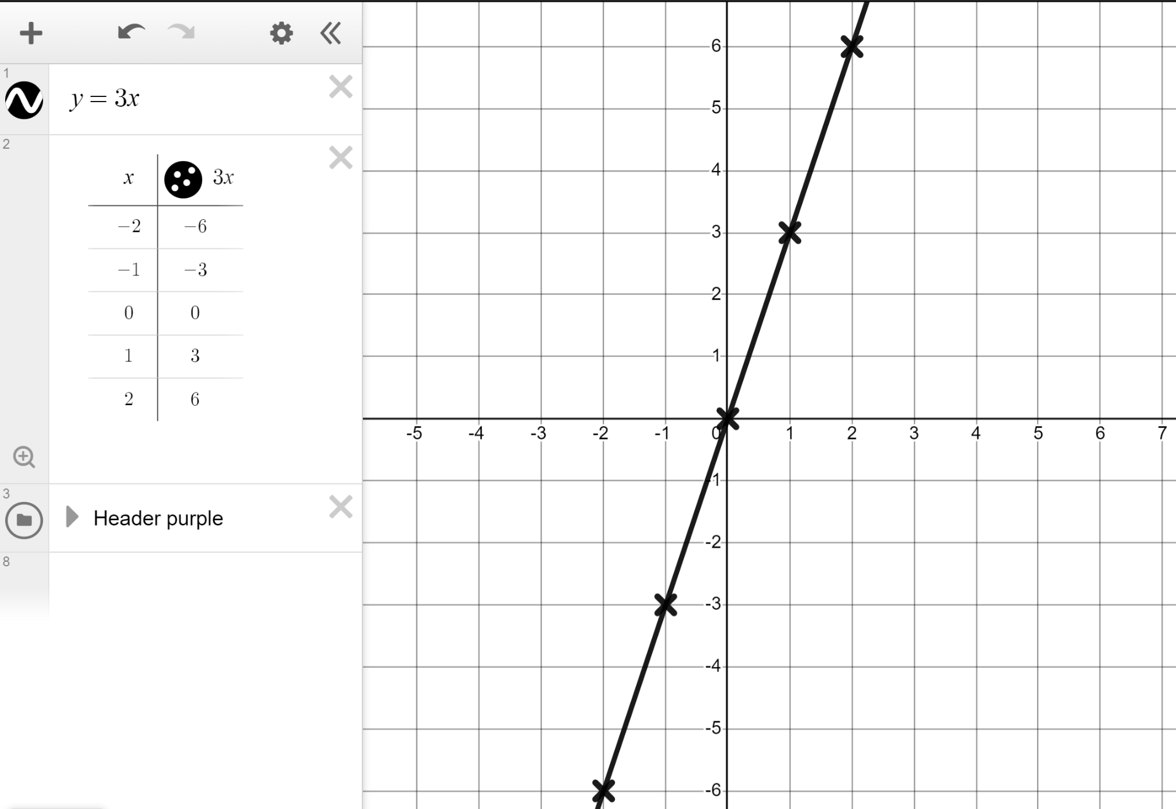
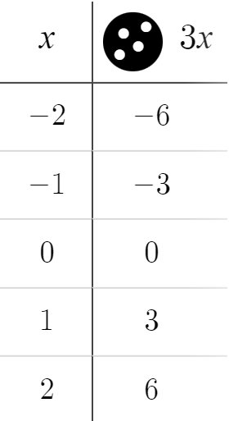
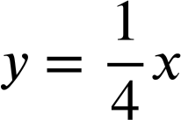
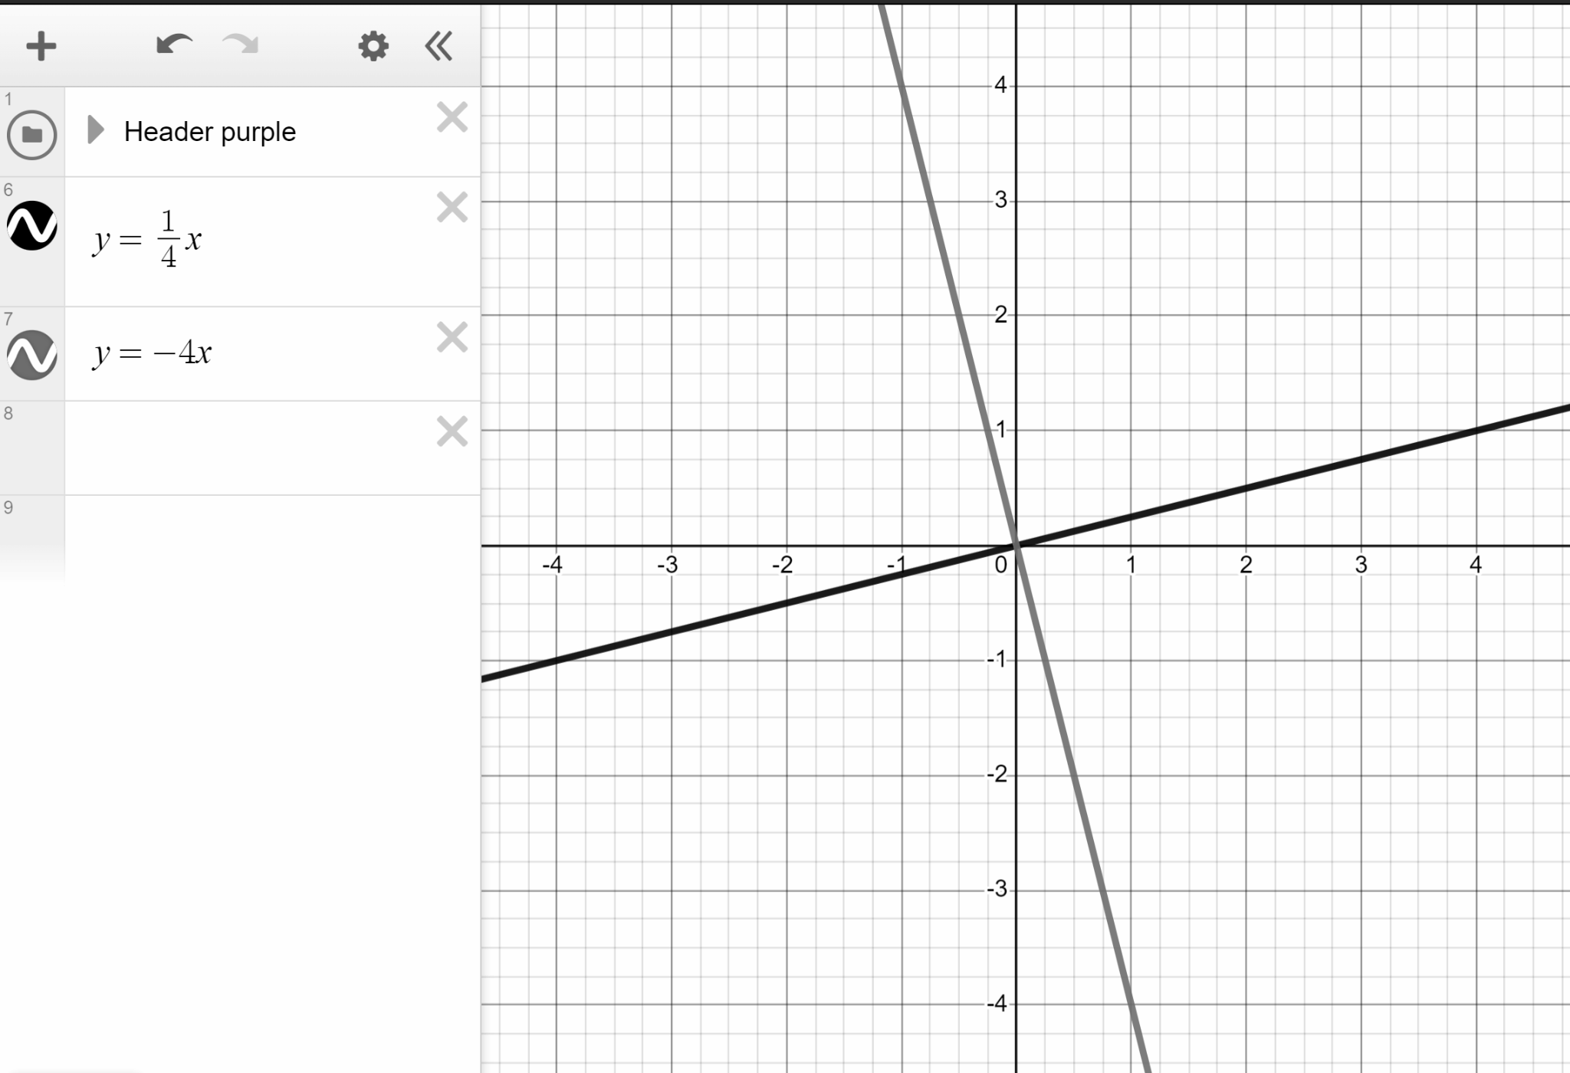

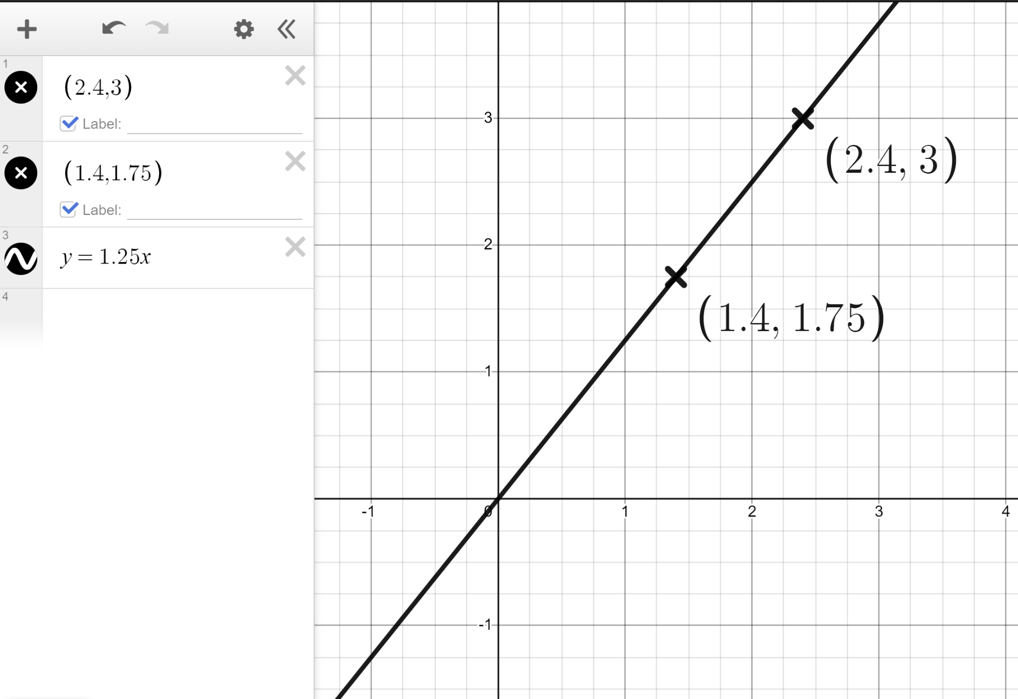
Using dynamic software to explore linear relationships
Task A: Changing the gradient
1) You are the teacher.
Plot the line y = 3x and explain to our Oak students the link between the algebra, the table and the graph.
You may have said:
The algebra (y = 3x) tells us that the y-coordinate is 3 times the x-coordinate; the table and coordinates reflect that.
In y = mx the m represents the gradient. For y = 3x we see the gradient of 3 on the graph and a change of +3 in y for every +1 change in x in the table.
2) Plot the lines y = −4x and
Compare the two lines.
You may have said:
Same y-intercept of (0,0)
One has a positive gradient, one a negative gradient.
Respective gradients of −4 and
3) Plot the coordinates (2.4, 3) and (1.4, 1.75) and draw the straight line that goes through both and the origin. What is this line?
Between the coordinates you see a change of +1 in x and +1.25 change in y telling us there is a gradient of +1.25
Lines in the form of y = mx go through the origin.
With a gradient of +1.25 this must therefore be the line y = 1.25x
4) Draw the lines that recreate this pattern.

Slide 2
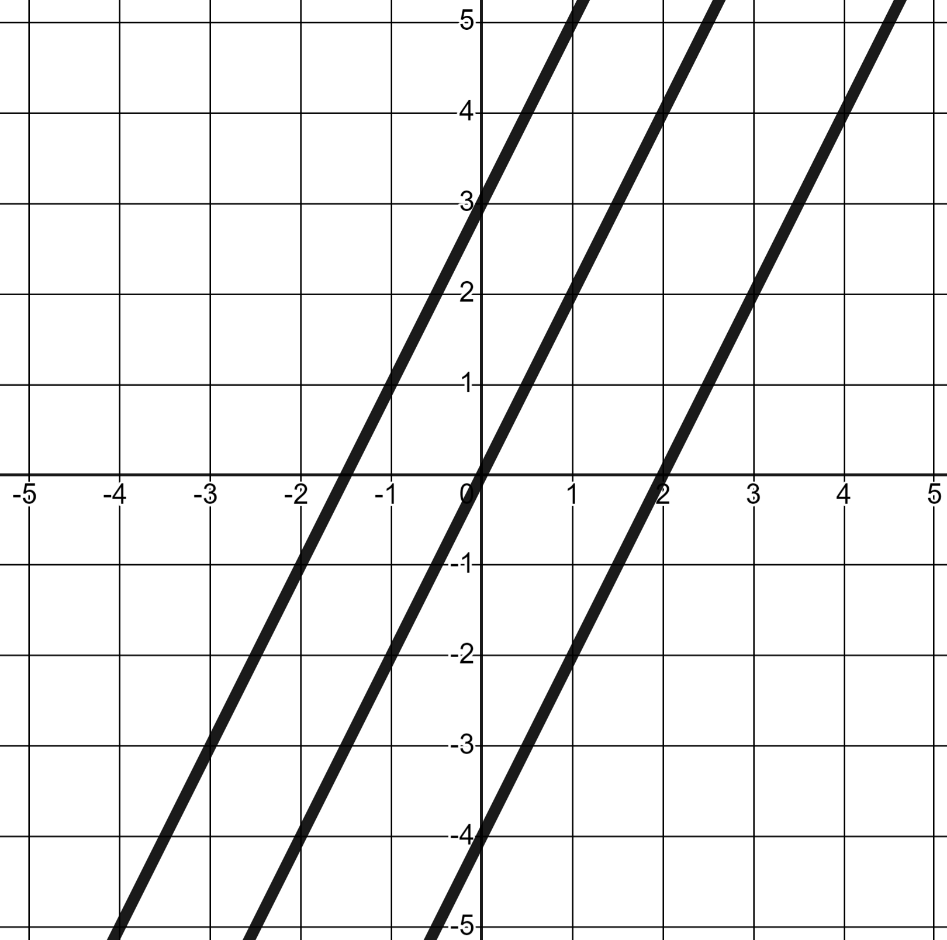
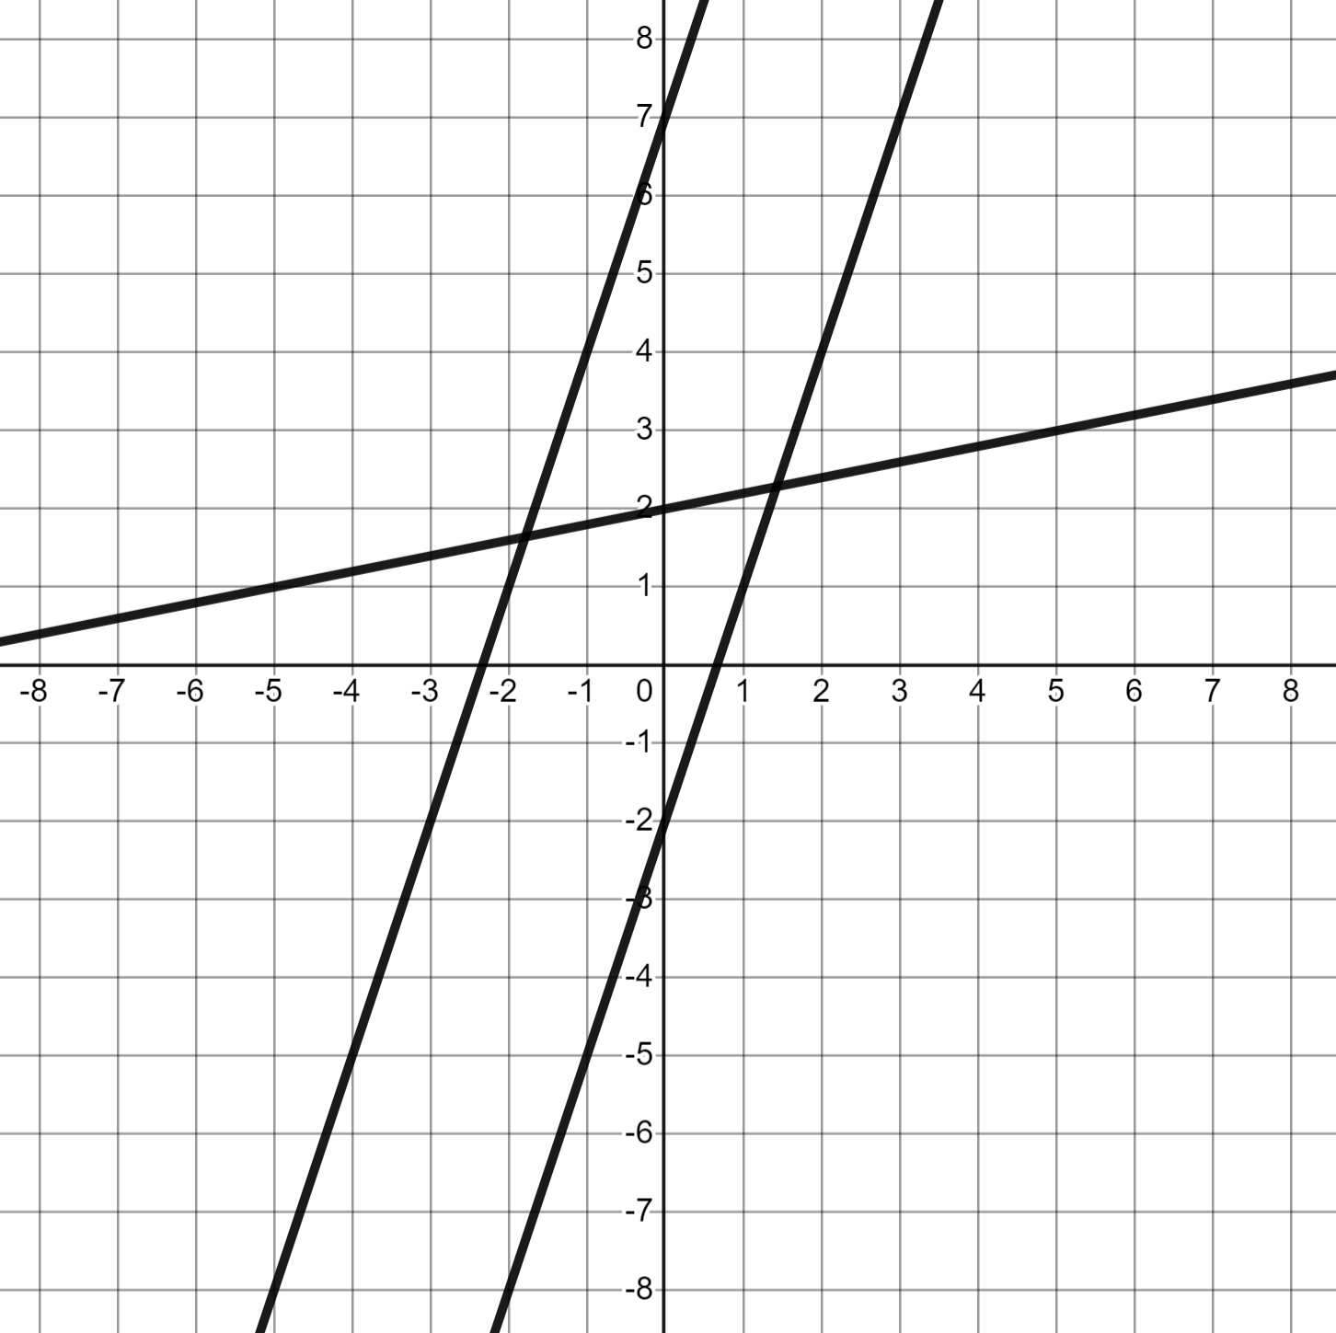
Using dynamic software to explore linear relationships
Task B: Changing the y-intercept
1) Plot the lines and write a sentence or two comparing them.
y = 2x
y = 2x + 3
y = 2x − 4
All three lines have the same gradient 2
This makes them parallel.
Translation of y = 2x by +3 in the y-direction. y-intercept of (0, 3)
Translation of y = 2x by −4 in the y-direction. y-intercept of (0, −4)
2) Plot the lines and complete the table.
Line | Gradient | y-intercept
y = 3x + 7 | 3 | (0, 7)
y = 3x − 2 | 3 | (0, −2)
y = 0.2x + 2 | 0.2 | (0, 2)
y = 7x − 3 | 7 | (0, −3)
y = 7 − 3x | −3 | (0, 7)

Slide 3
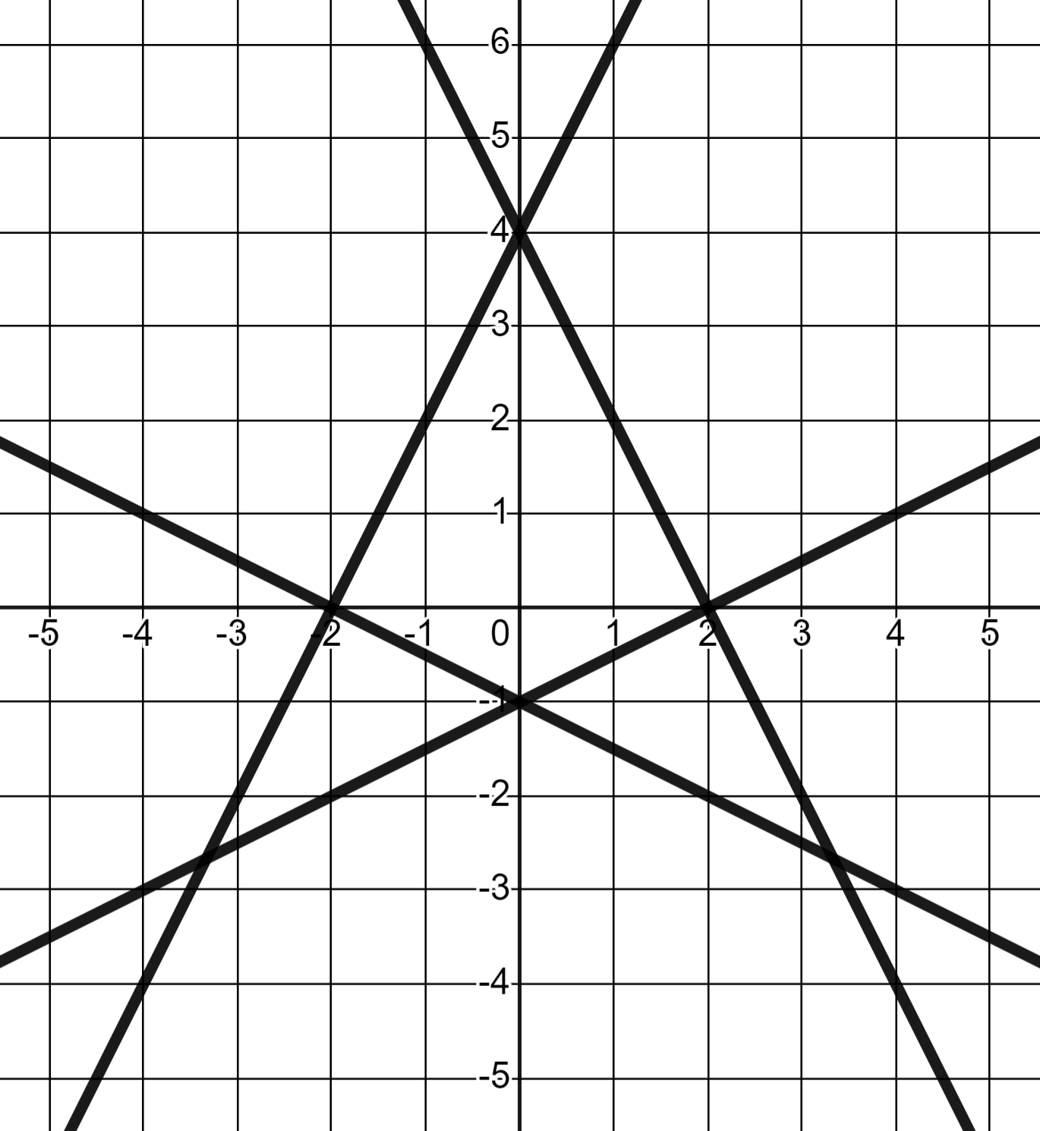
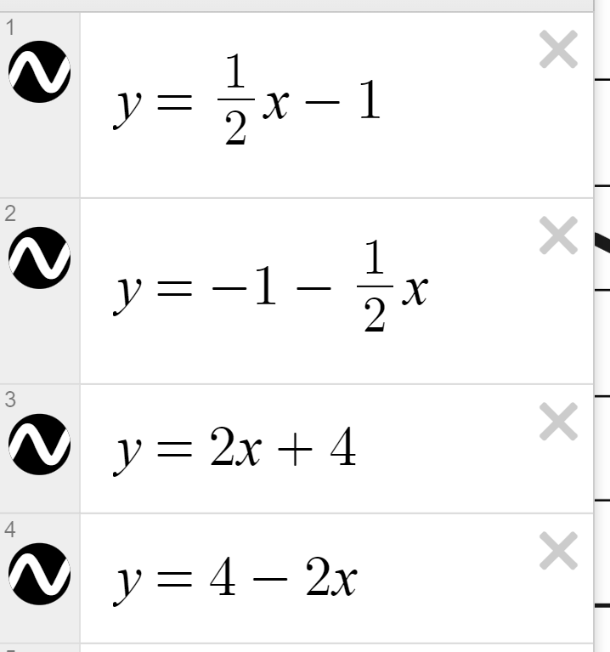
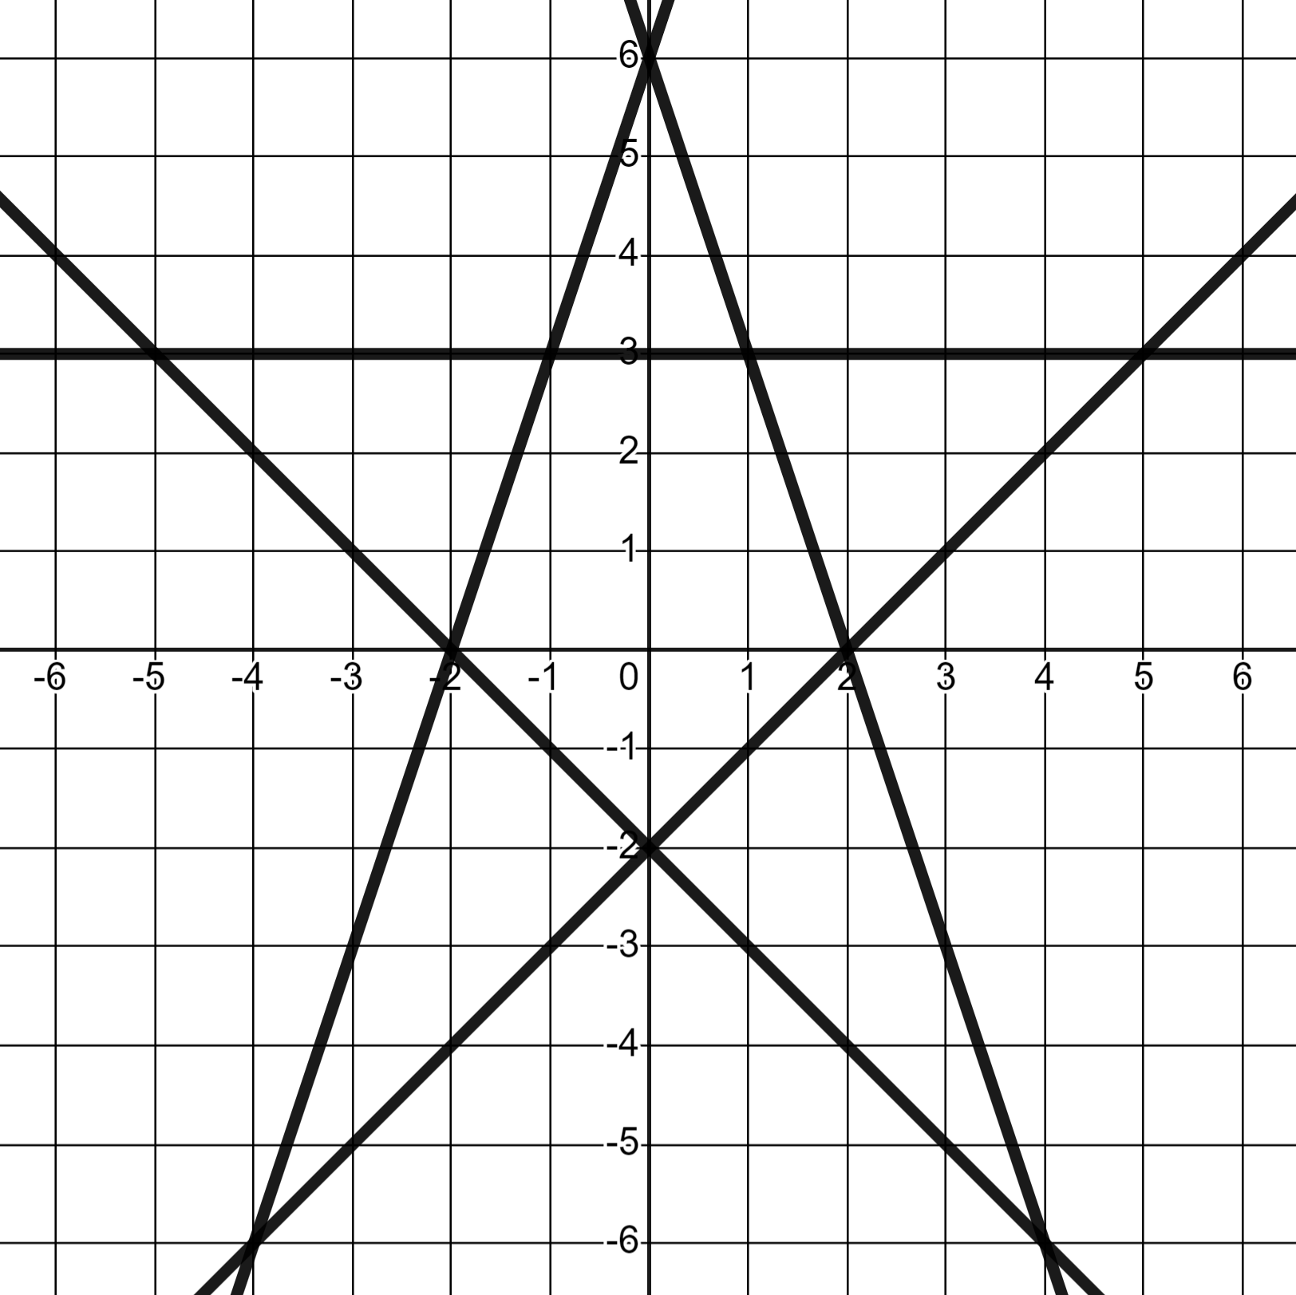
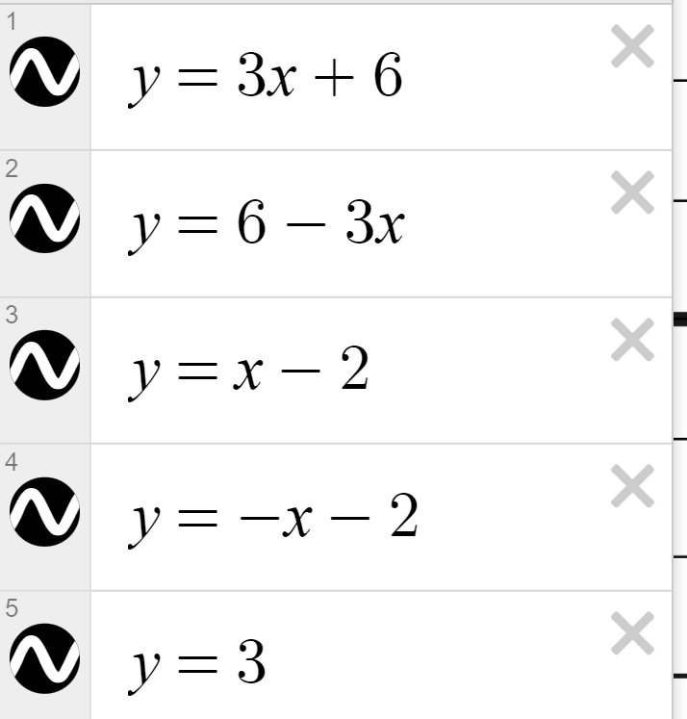
Using dynamic software to explore linear relationships
3) Draw the lines that recreate these patterns.
a)
Two lines of y-intercept (0, 4), two lines of y-intercept (0,−1)
b)
y-intercepts of (0, 6), (0, 3), and (0,−2)
Mathematics in Education and Industry
v2.2

